Slide 1
Annual
Report
July 1 2014 -June 30 2015
“Gateway Lights Up the Community”

Slide 2
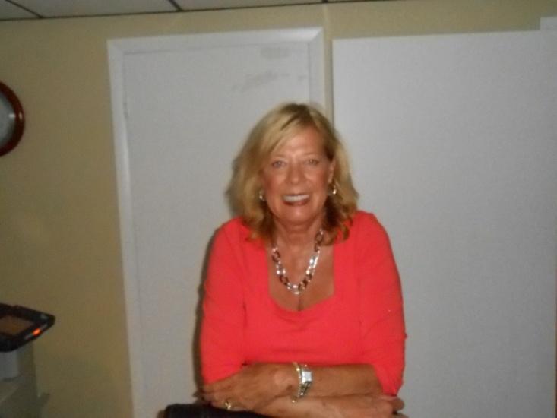
Message from Our
President & CEO
I am delighted to announce that we have reached our twentieth year of serving our community. We proudly served over 9,700 families this past fiscal year. We have 7 sites (including our main office) in Broward County and one in Palm Beach County. We quickly offer assistance needed to stabilize a household by providing food, case management, rental or mortgage assistance, referrals and other ancillary services. Our main asset is the ability to give quality and quantitative case management. The crucial areas addressed by this organization are hunger, economic crisis intervention and filling the gaps in services and resources whenever necessary. Hungry people receive immediate assistance and guidance while overcoming their crisis; problems are identified, and solutions are planned. In our community, we are often the first line of defense, in the war against personal disaster.
Gateway Community Outreach is grateful for the incredible number of dedicated partners, people and companies who provided food, financial support or volunteer hours to those less fortunate in our communities. Your support is genuinely making a difference. With your food, financial support and with your volunteer hours, you are demonstrating that you care for people who find themselves in need of a hand up, not a hand out, during some genuinely difficult circumstances. Thank you for ensuring that everyone has a place at the table, and for fighting hunger and feeding hope. Our work is needed and our work continues. Thank you for making an impact in the lives of friends and neighbors.
Please visit our website at www.gcoflorida for updated information and events.
Carol A. Ray

Slide 3
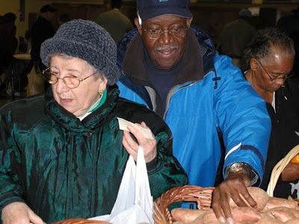
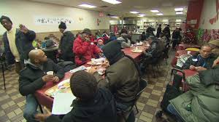
Program
Highlights
With seven (7) satellite sites in operation within Broward and Palm Beach Counties, Gateway Community Outreach sites are staffed with a magnitude of volunteers dedicated and committed to the needs of those in their communities. In 2014 our volunteers provided over 18,000 hours of service towards Gateway efforts. Our sites provided the following services:
Intake/Assessment of Need
90-Day Crisis Intervention Treatment Program
Case Management Services
Food Baskets
Rent/Mortgage Assistance
Bus Passes
Walmart Gift Cards for clothing
Special Needs Food
Water bill assistance
Baby Needs
Children Summer food boxes
Special Touch Holiday Events
Food Stamps
Medicaid
Plus Extensive Referral Services That Include:
Clothing
Furniture
Utility Assistance
Homeless Helpline
Transportation Assistance (T.O.P.S.)
Looking Ahead:
Gateway Community Outreach is seeking to expand services by actively looking to collaborate with other organizations to open other satellite sites throughout Broward County.

Slide 4
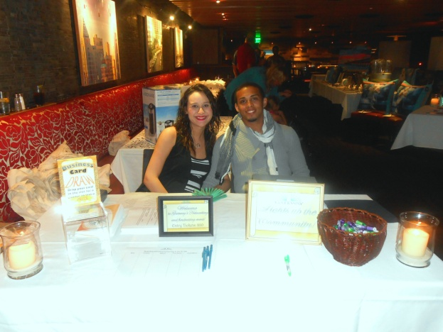
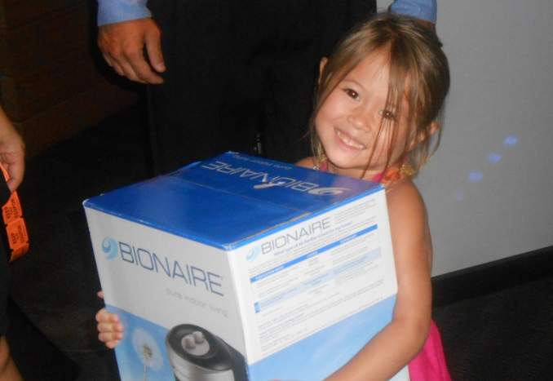
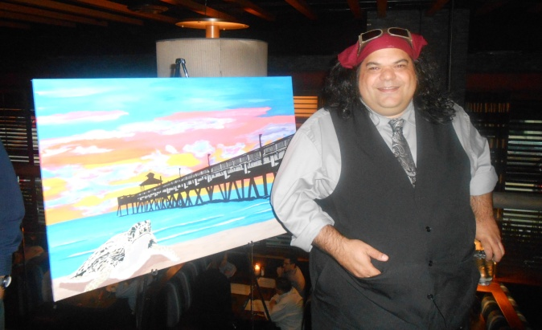
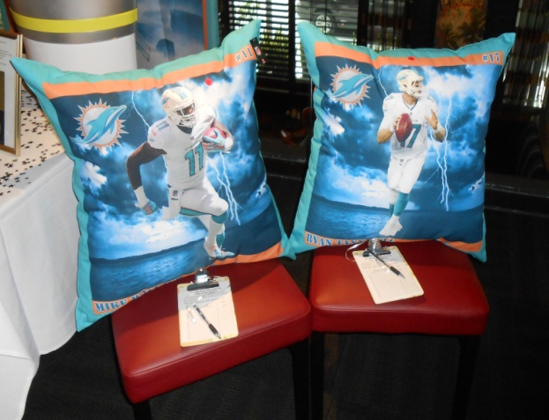
Fundraising Event at “Grille 401”
Gateway Community Outreach hosted a business and social networking event to bring community awareness to the public. The Silent Auction and Networking affair proved to be a fun-filled night for everyone. The photos reflect some of the items that were auctioned such as beautiful artwork, autographed NFL items, spa gift certificates and many other items to raise money for Gateway Community Outreach’s Mission to safeguard and protect the most vulnerable community members.

Slide 5
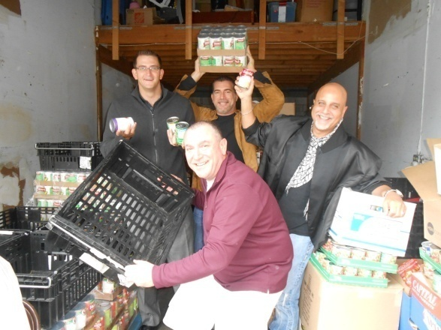
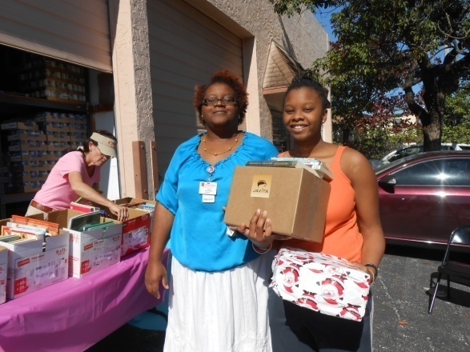
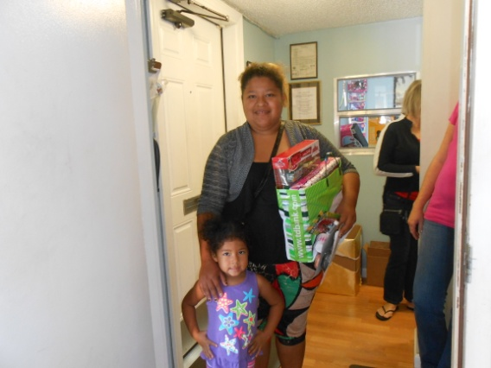
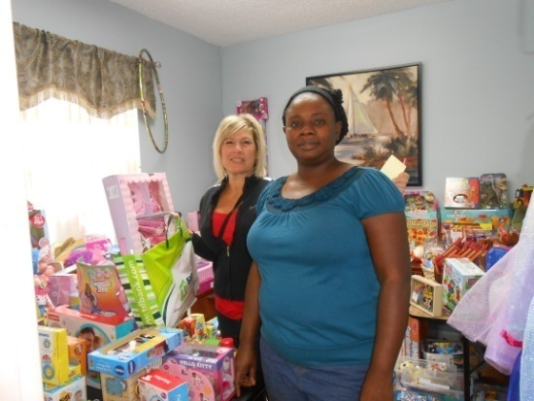
“2014 Holiday Special Touch”
and Children’s Summer Food Boxes Distribution
Our “Special Touch” program is designed to provide a “Special Touch” to those families, individuals and children who are in extra need during specific times of the year. The holiday season is suppose to be a joyous time, but for some it can be a depressing and lonely time of the year. Gateway Community Outreach provides hope and compassion to those families who are experiencing tough economic times. Our Summer Distribution of Children’s Box program provides our youth with a healthy food box just for them. Nutritious and fun food for those young appetites are provided to those that may not have a lunch due to school being closed. During the holiday season our “Special Touch” Holiday program provides quality ingredients for a complete, healthy, fresh holiday meal for families to cook and enjoy with each other. During the month of December Gateway provides toys for our young tots, wrapping paper, gift cards and personal hygiene products for all members of the family. Gateway Community Outreach helps make the holiday season a joy-filled time of the year for the families we serve. We strive to continue to bring joy to all.

Slide 6
A Warm Thanks To Our Partners
Gateway Community Outreach is proud to acknowledge certain corporate alliances whereby through deed or monetary pledge supported GCO’s focus and mission:
Broward First Call for Help - 211
Career Source of Broward County
Children’s Diagnostic & Treatment Center
Children Services Council
Coalition to End Homelessness
Community Presbyterian Church
Consolidated Credit Solutions, Inc.
Covenant House
Deerfield Beach High School
Ft. Lauderdale Housing
Jewish Family Services
Life Net For Families
N.E. Focal Point
Whole Food Markets
Papa Johns
Project Lifeline
Publix
Soref
Starbucks
Wal-Mart

Slide 7
A Warm Thanks To Our Donors
Gateway recognizes the following Corporations, Foundations and Organizations that have contributed to the success of Gateway in 2014- 2015. We apologize for any omissions.
Batchelor Foundation Inc.
BJ’s Charitable Foundation
Blum Foundation (Walter & Adi Blum)
CFC-Atlantic Coast Combined Federal Campaign
Community Foundation Of Broward
Coral Springs Community Chest
Edward W. Smith Foundation
Enterprise Holdings Foundation
Ford Foundation
Florida Power & Light
Harry Kramer Memorial Fund
Holy Cross Hospital (John C. Johnson)
Jarden Consumer Solutions
The Jim Moran Foundation
Kopp Family Foundation
Lawrence A. Sanders Foundation
The Martha G. Moore Foundation
Publix Supermarket Charities Inc.
Schmidt Family Foundation
Sun-Sentinel Children’s Fund (A McCormick Foundation Fund)
T.J. Maxx and TJX Foundation
United Way of Broward County (Project Lifeline)
Wal-Mart Foundation
William R. Watts Foundation Inc.
Wells Fargo and Company
Whole Foods Market
Zale Foundation ( M.B. & Edna Zale)

Slide 8
Distribution Report
Each client receives individualized case management that meets their needs to assist them on the road to self-sufficiency. This fiscal year we assisted 26,882 individuals, consisting of 9,700 heads of household, 8,627 children and 8,555 additional adults.

Slide 9
Clients’ ethnicity show mild variations over the past years, although these fluctuations are not statistically significant. Please see chart below for variations.
Client
Ethnicity

Slide 10
Senior Services Report
The senior population, is one of our main focuses at Gateway Community Outreach. We work diligently to provide food, financial assistance for rent /mortgage and water bill assistance. We provide additional referral services such as; help with SNAP, Medicare Buy-In applications, faxing required documentation to other agencies and advising client about other state/federal benefits that they may be eligible for. This year Gateway Community Outreach served almost 3,000 seniors with food, provided $1,247 for water bill assistance and $8,737 for rent/mortgage assistance to prevent homelessness.
Food Pantry # of Senior Clients Served | 2,957
Water Bill Assistance Paid by Gateway Community Outreach | $1,247
Rent/Mortgage Paid by Gateway Community Outreach | $8,737

Slide 11
Gateway Community Outreach Wish List
Commercial shredder
Computer Programmer
Computer Server
Food donations
Forklift
Freezers
Fundraising/
Marketing Development
Grant Writer
Main office volunteers
Monetary Donations
New Brochure
New Computers
New Sign for main office
Organizer of Food Drives
Pallet Jack
Professional Photographer
Public Accountant
Public Relations
Refrigerated truck
Refrigerators
Shelves for the warehouse
Software
Sponsorship for Fundraising and Galas
Van
Warehouse Fans
Warehouse Volunteers

Slide 12
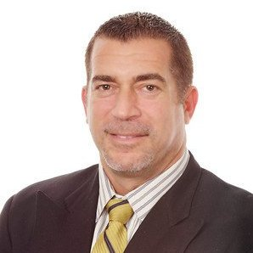
Board
of
Directors
Board
of
Directors
-President & CEO
Carol Ray
Jose
Garces
Spencer
Ely
Carol
Fernaays
Anne
Tanis
Josef
Zappoli
Robert
Denton
Advisory Board Members
Robert Bonham
Pastor Gary Dolphus
Deana Thomas

